Slide 1
Tutorial 5: Nested-Loop and IF-ELSE

Slide 2
Outline of this tutorial: 1. Online Java Coding Tool: replit.com 2. Nested Loop 3. Loop with IF-ELSE

Slide 3
Sign-up a NEW student account on Replit.com
You MUST use your CU @Link Email to sign-up, e.g.,
11xxxxxxxx@link.cuhk.edu.hk
Sign-up ONCE only.
Join 2021-22 CSCI1130 exercises: https://bit.ly/3zABQ4W
Please DO NOT use your other personal email address to sign-up. For example, DO NOT use Gmail,
Outlook, qq, 163.com, etc. EVEN NEITHER your_nickname_alias@cuhk.edu.hk NOR
username@CSE/IE/STAT/DEPT.cuhk.edu.hk !
Exercises on Replit.com are OPTIONAL and such scores will NOT be counted towards your course grade.

Slide 4
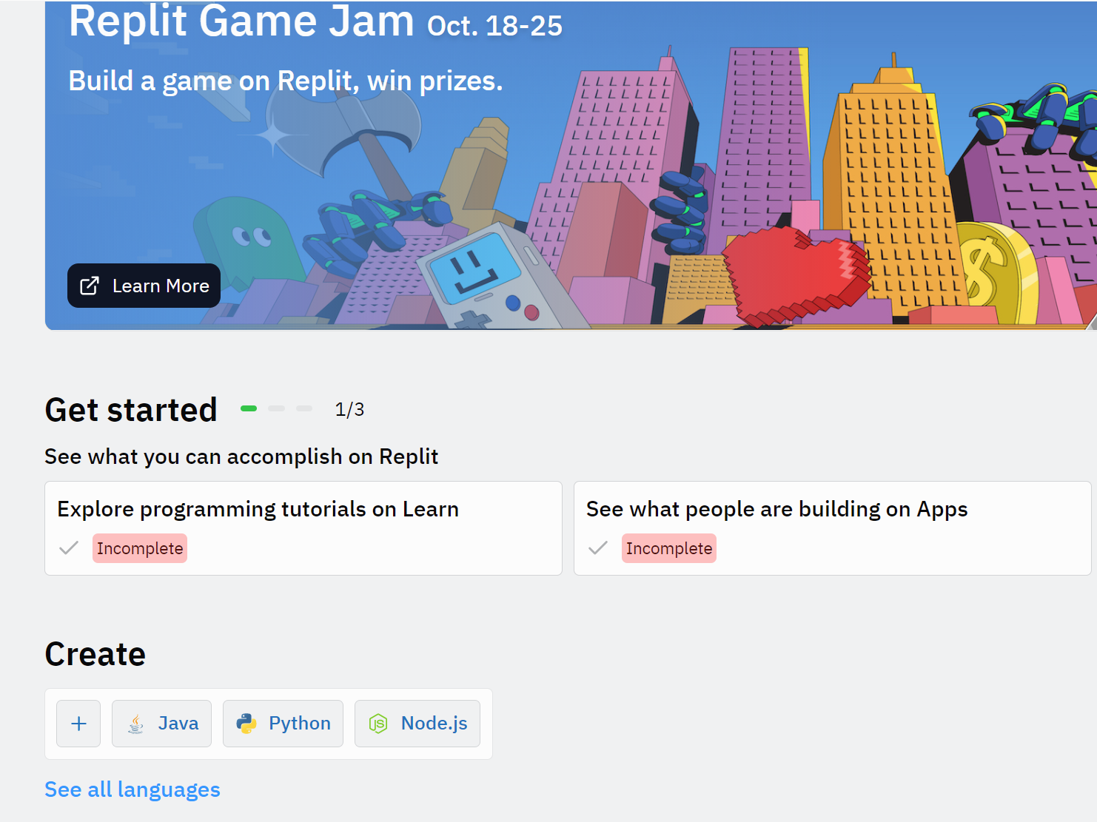
Online Coding
Running your program online: https://replit.com
Register an account and select “Java” language;

Slide 5
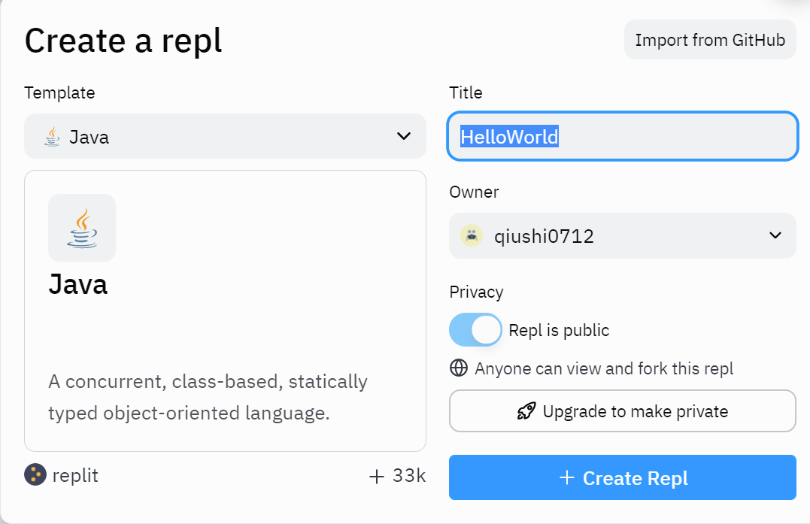
Online Coding
Running your program online: https://replit.com
Register an account and select “Java” language;
2. Click on “Java” and create a online project, e.g., “HelloWorld”;

Slide 6
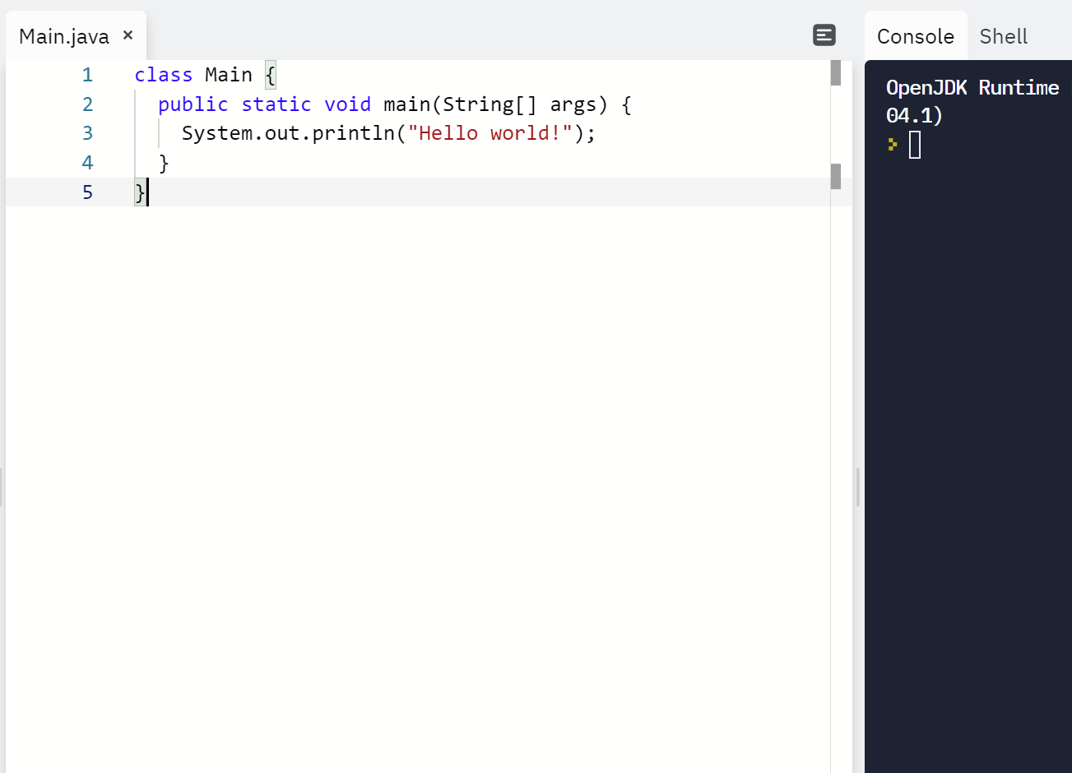
Online Coding
Running your program online: https://replit.com
Register an account and select “Java” language;
Click on “Java” and create a online project, e.g., “HelloWorld”;
Start coding and running, with console showing the output of your programs.

Slide 7
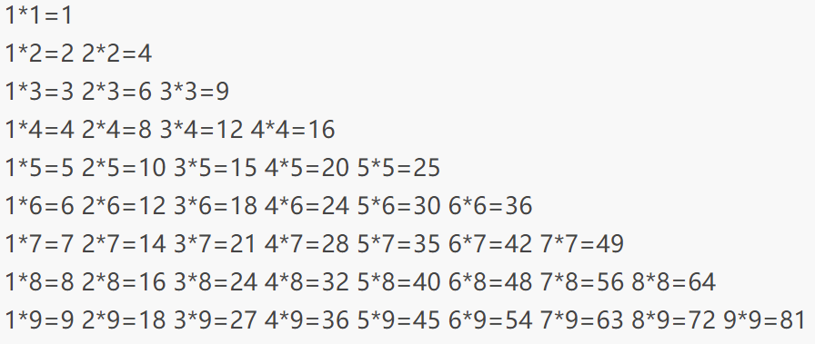
Nested Loop
Example 1: Print the multiplication formula table as below?

Slide 8
Nested Loop
Java implementation:
class Main {
public static void main(String[] args) {
System.out.println("Hello world!");
// Outer Loop
for (int i = 1; i <= 9; i++) {
// Nested Loop
for (int j = 1; j <= i; j++) {
System.out.print(j + "*" + i + "=" + j * i + "\t");
}
System.out.println();
}
}
}

Slide 9
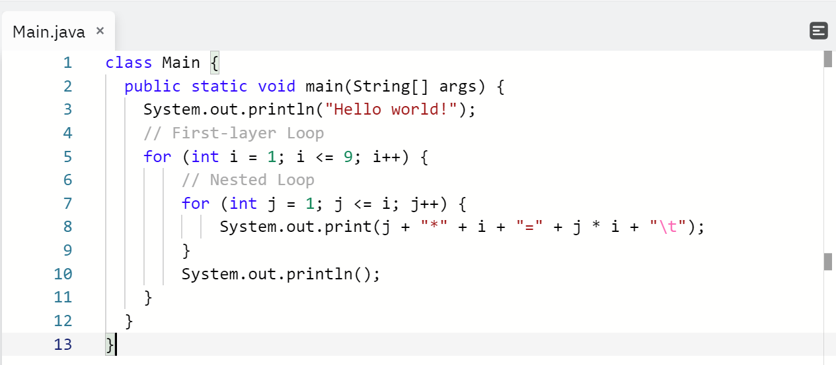
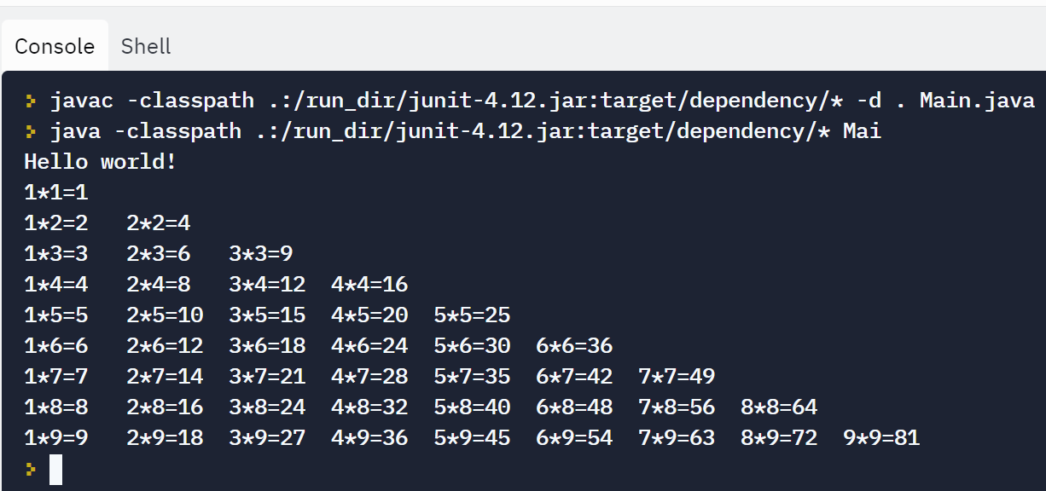
Nested Loop
Example 1: Running results in replit.com

Slide 10
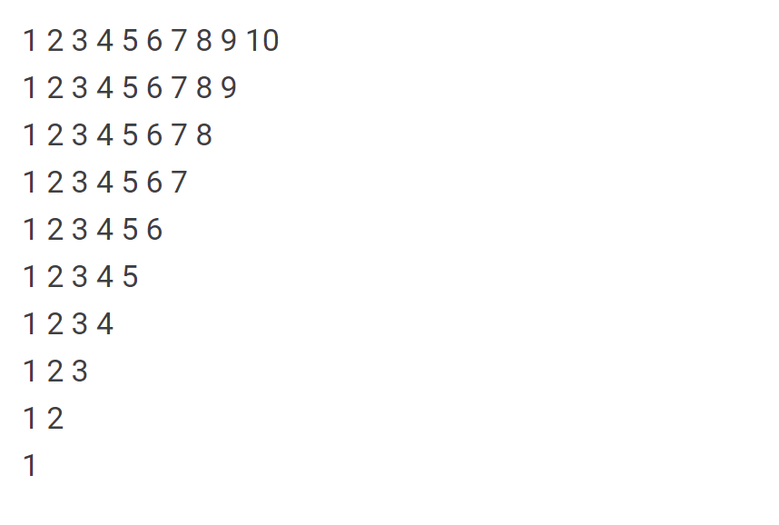
Nested Loop
Example 2: Print the inverted triangle number array as below?

Slide 11
Nested Loop
class Main {
public static void main(String[] args){
int num_lines = 10;
for (int y=0; y<num_line; y++) {
for (int x=num_line; x>y; x--) {
System.out.print(x);
System.out.print(' ');
}
System.out.println();
}
}
}

Slide 12
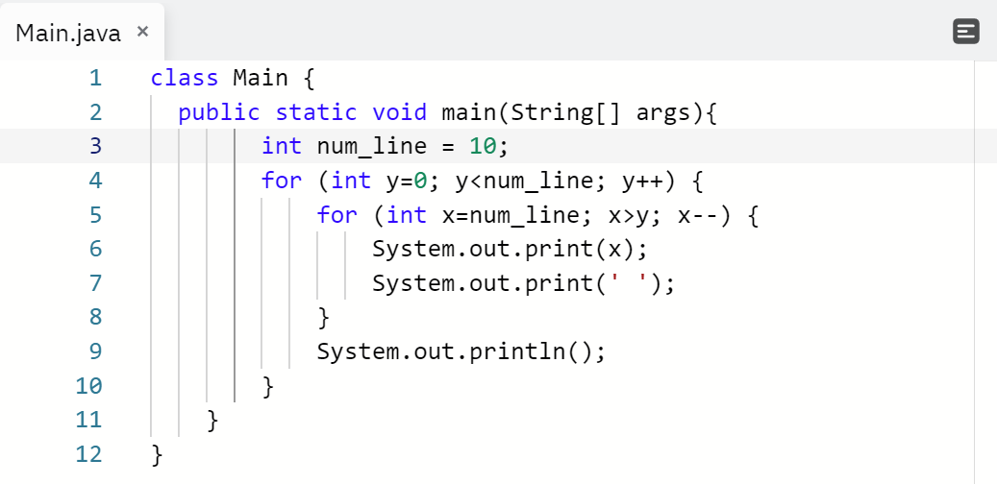
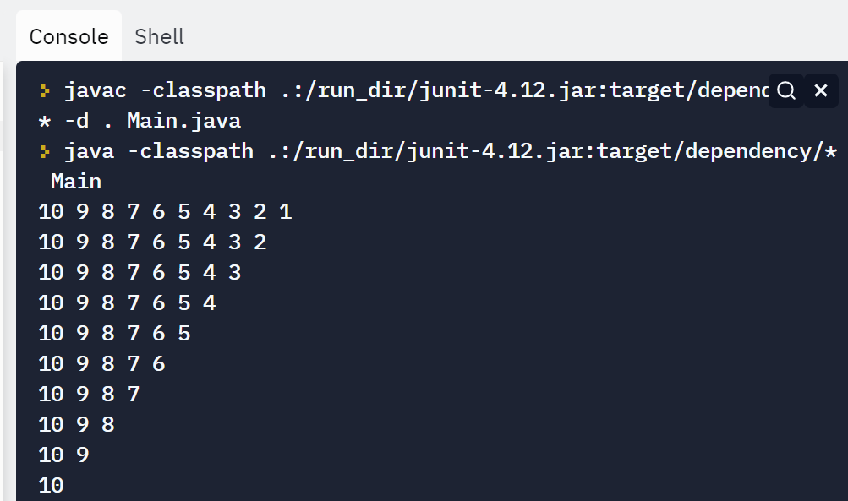
Nested Loop
Example 2: Running results in replit.com

Slide 13

Nested Loop Exercise
Try to print a prism with the character “*”, as shown in the right figure. It consists of 9 lines in total, please note that there is a space between every two stars.
class Main {
public static void main(String[] args){
for (int i = 0; i < 5 ;i++){
for (int j = 0;j < 4 - i;j++ ){
System.out.print(" ");
}
for (int k = 0;k < i + 1 ;k++){
System.out.print("* ");
}
System.out.println();
}
for (int i = 0; i < 4 ;i++){
for (int j = 0;j < i + 1;j++ ){
System.out.print(" ");
}
for (int k = 0;k < 4 - i ;k++){
System.out.print("* ");
}
System.out.println();
}
}
}

Slide 14
Loop with IF-ELSE
Example 1: Calculate the sum of all odd and even numbers between 0 and 100 separately?
class Main {
public static void main(String[] args){
int sum_odd = 0;
int sum_even = 0;
for (int i = 0; i <= 100 ;i++){
if (i % 2 == 0){
sum_even = sum_even + i;
}
else{
sum_odd = sum_odd + i;
}
}
System.out.print("Sum of all odd numbers: ");
System.out.println(sum_odd);
System.out.print("Sum of all even numbers: ");
System.out.println(sum_even);
}
}

Slide 15
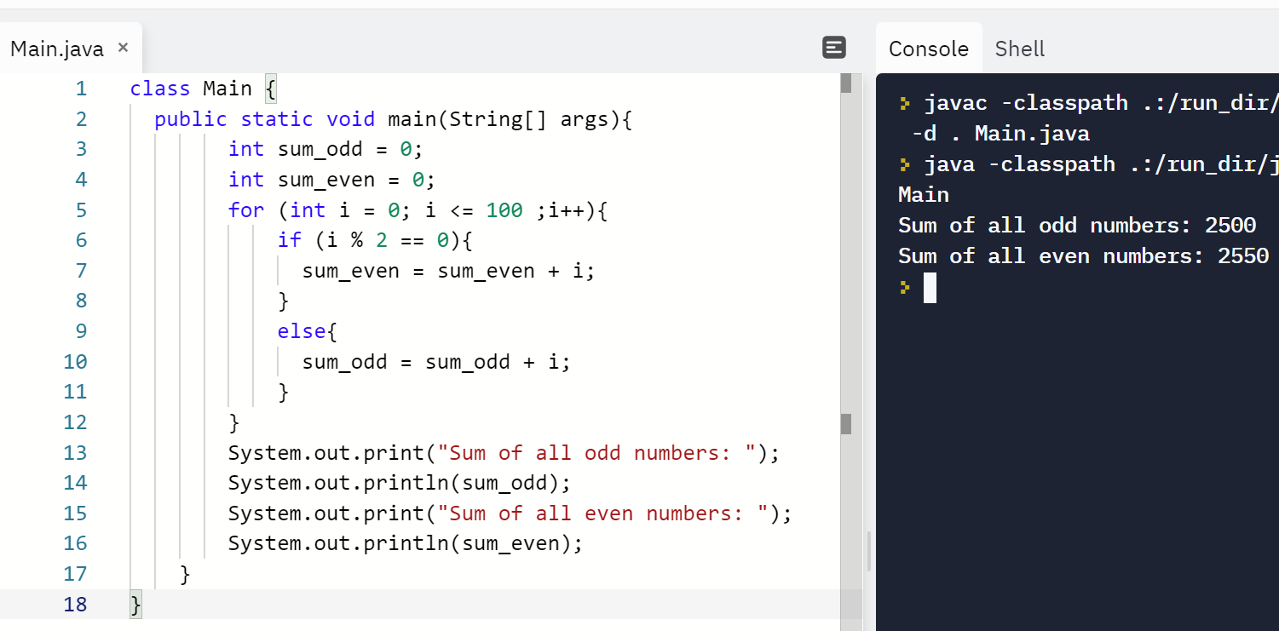
Loop with IF-ELSE
Example 1: Calculate the sum of all odd and even numbers between 0 and 100 separately?

Slide 16
Thanks for your attention

